Slide 1
The Power of
Machine Learning
Presented By: Fatir Sheikh

Slide 2
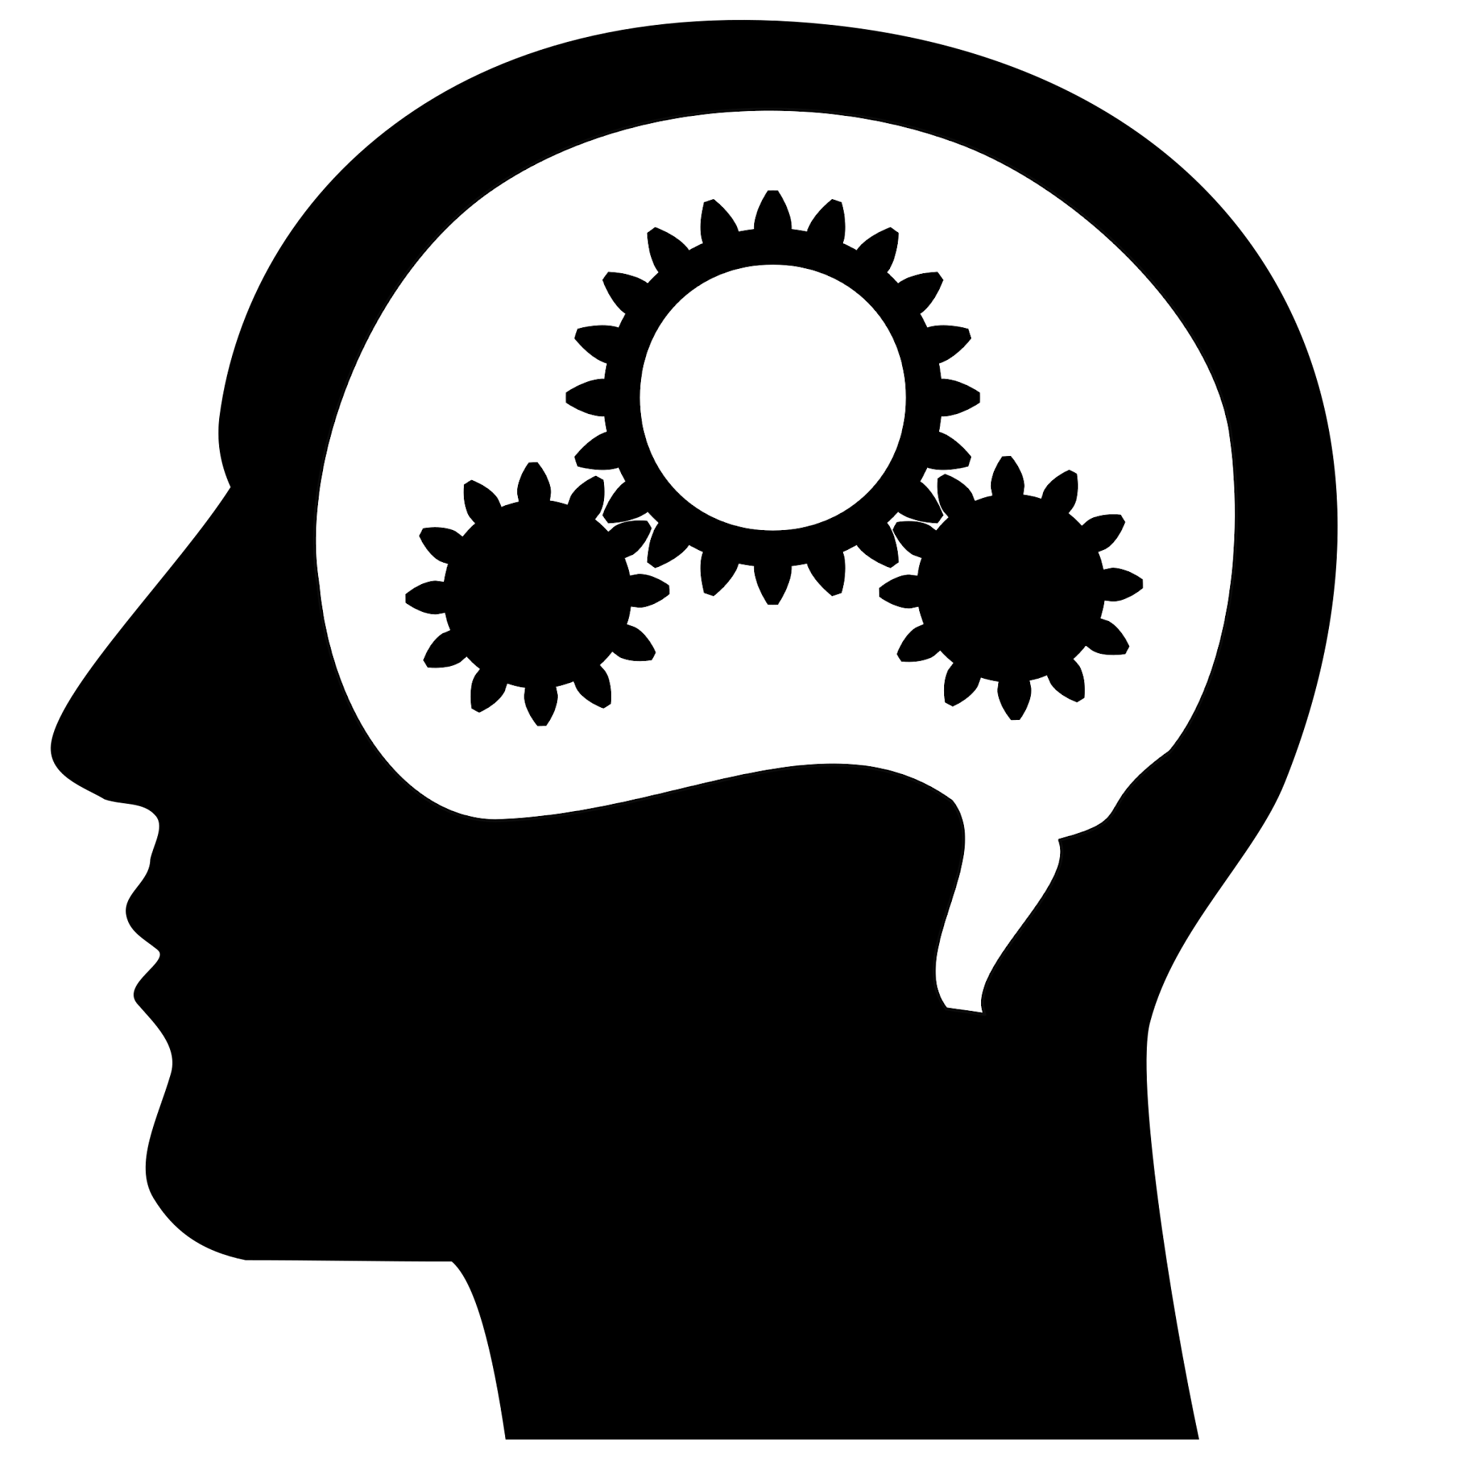
What Is Machine Learning:
Machine Learning is a subfield of artificial intelligence that has its primary focus on the creation and development of algorithms and models that enable computers to learn and make decisions without explicit programming.

Slide 3
What Does It Specifically Do:
Pattern Recognition: Machine learning algorithms can identify and recognize complex patterns and relationships within large datasets, making it useful in a wide range of applications, from image and speech recognition to fraud detection and recommendation systems.
Classification: Machine learning algorithms can categorize data into different classes or groups. For instance, they can classify emails as spam or not spam, diagnose diseases based on medical data, or categorize products on an e-commerce website.
Autonomous Decision-Making: In autonomous systems like self-driving cars and drones, machine learning plays a crucial role in making real-time decisions based on sensor inputs and environmental data.

Slide 4
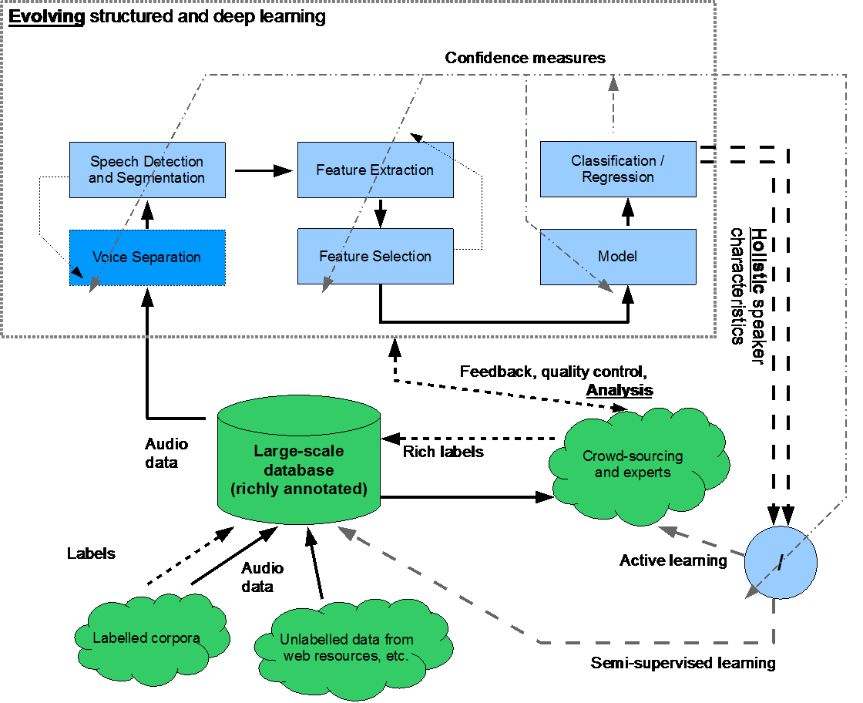
What Does It Specifically Do:
Speech and Voice Recognition: Machine learning is used to transcribe and recognize spoken language, enabling voice assistants like Siri and Google Assistant.
Image and Video Analysis: Machine learning can analyze and process images and videos, enabling applications like facial recognition, object detection, and content moderation on social media platforms.

Slide 5
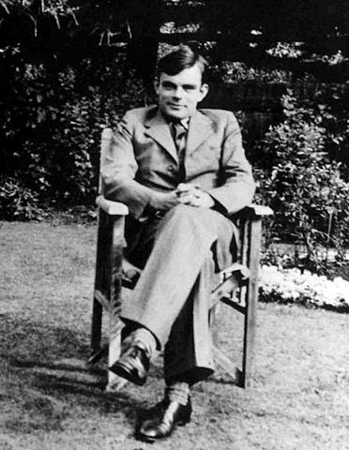
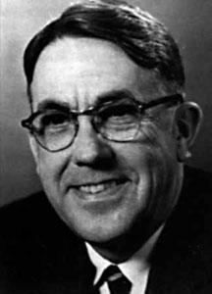
The History of Machine Learning:
Early Development (1950s-1960s): The concept of machine learning was introduced by pioneers such as Alan Turing and Arthur Samuel. Turing proposed the idea of machines that can simulate human intelligence, while Samuel developed the first self-improving program, a checkers-playing computer program.
(1970s-1980s): The field of Artificial intelligence, including machine learning, experienced a period of reduced funding and progress during the "AI winter." The ambitious goals set in the early days were often unattainable with the technology of the time.

Slide 6
The History of Machine Learning:
Resurgence (1990s): Machine learning experienced a resurgence in the 1990s due to advances in computing power and the development of more sophisticated algorithms. Neural networks, a fundamental component of deep learning, also gained attention during this period.
Deep Learning Revolution (2010s): The most recent and significant breakthrough in machine learning has been the rise of deep learning, which involves artificial neural networks with many layers. This development, aided by powerful GPUs, has enabled significant progress in areas such as image and speech recognition.

Slide 7
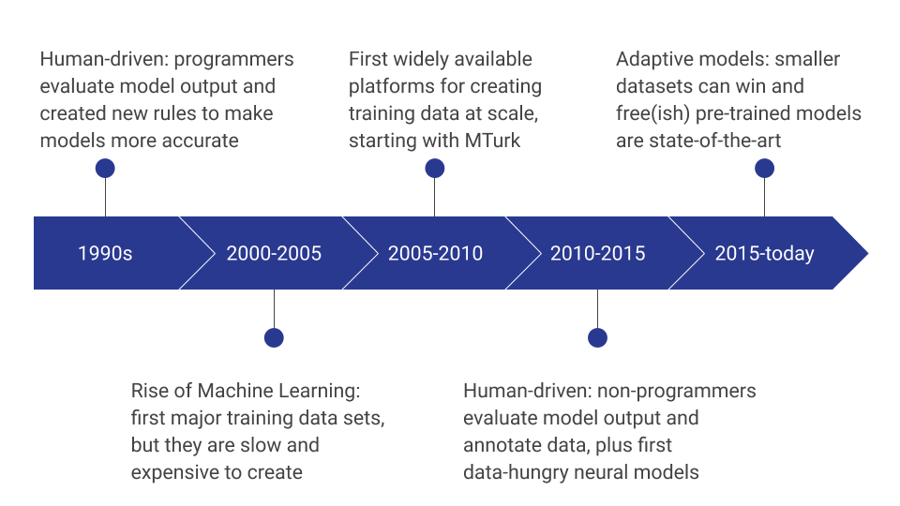
https://towardsdatascience.com/a-brief-history-of-training-data-9c513fc95b3e

Slide 8
Types of Machine Learning
Supervised Learning: This subtopic involves training a machine learning model with labeled data, where the correct outcomes are known. The model learns to make predictions or classifications based on input data.
Unsupervised Learning: Unsupervised learning deals with unlabeled data, aiming to discover hidden patterns, structures, or groupings within the data. Clustering and dimensionality reduction are common techniques in this subfield.

Slide 9
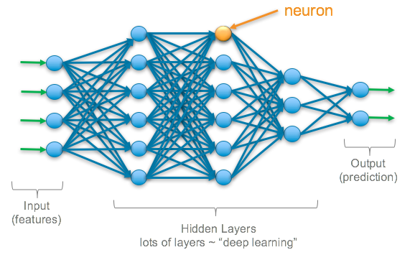
Types of Machine Learning
Deep Learning: Deep learning is a subfield of machine learning that emphasizes the use of artificial neural networks with multiple layers (deep neural networks). It has been particularly successful in tasks like image and speech recognition.

Slide 10
Industries With Machine Learning
Healthcare: Machine learning is used for disease diagnosis, drug discovery, and personalized treatment recommendations. It can analyze medical images, predict patient outcomes, and identify health trends.
Finance: In the financial industry, machine learning is employed for fraud detection, algorithmic trading, credit risk assessment, and customer service automation. ML models can analyze market data and make real-time trading decisions.

Slide 11
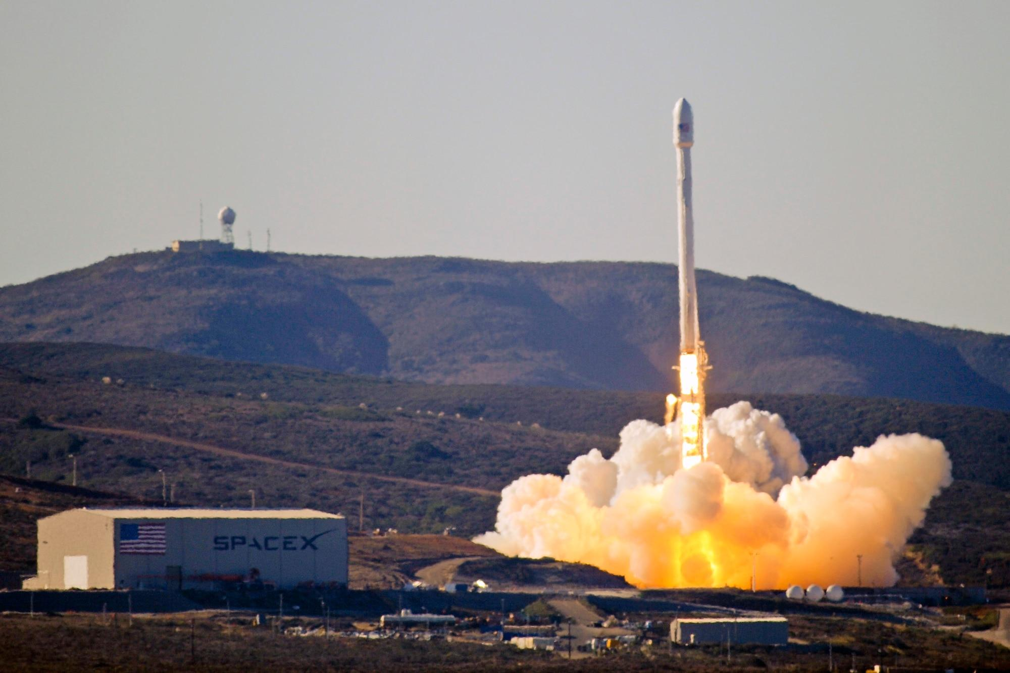
Industries With Machine Learning
Manufacturing: ML is employed in predictive maintenance, quality control, and supply chain optimization. It helps reduce downtime and improve production efficiency.
Environmental Monitoring: Machine learning is used for analyzing climate data, predicting natural disasters, and optimizing energy consumption in smart grids.
Space Exploration: In space research, ML aids in analyzing vast amounts of data from satellites and telescopes, assisting in the discovery of celestial objects and patterns.

Slide 12
Benefits of Machine Learning
Machine Learning offers numerous benefits, including automation, efficiency, and enhanced decision-making. It enables data-driven insights by extracting valuable patterns and predictions from vast datasets. Businesses can improve customer experiences through personalized recommendations, optimize operations, and enhance fraud detection. In healthcare, it aids in early disease diagnosis. In autonomous systems, it ensures safer navigation. Machine Learning has transformed industries, driving innovation in finance, marketing, healthcare, and more. It has the potential to revolutionize various domains, making processes smarter, faster, and more precise, ultimately leading to cost savings and improved outcomes.

Slide 13
References:
1. 2. Brown, Sara. “Machine Learning, Explained.” MIT Sloan, 21 Apr. 2021, mitsloan.mit.edu/ideas-made-to-matter/machine-learning-explained.
2. Foote, Keith D. “A Brief History of Machine Learning.” DATAVERSITY, 4 May 2023, www.dataversity.net/a-brief-history-of-machine-learning/.
3. Karjian, Ron. “History and Evolution of Machine Learning: A Timeline.” WhatIs.Com, TechTarget, 22 Sept. 2023, www.techtarget.com/whatis/A-Timeline-of-Machine-Learning-History.
4. “Top Machine Learning Applications by Industry: 6 Machine Learning Examples.” Columbia Engineering Boot Camps, 21 Dec. 2021, bootcamp.cvn.columbia.edu/blog/machine-learning-applications/.
5. “What Is Machine Learning?” IBM, Columbia University, summer 2023, www.ibm.com/topics/machine-learning.

